Slide 1
UAV/S in GIS
Brookhaven College
Our 1st Flight Operation
July 2016

Slide 2
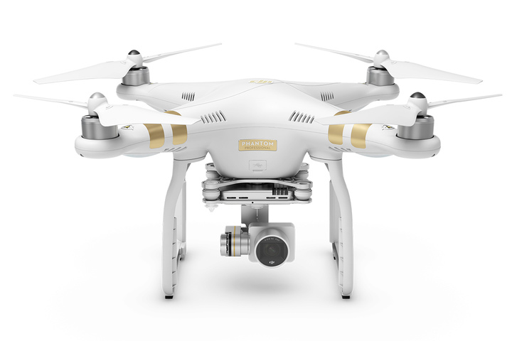
Can we fly the campus?
July 2016 Used COTS $2000 UAS
DJI Phantom 3 Pro
12 mp camera
This is turn-key; everything is integrated
Sensor and lens
Gimbal and mount
Flight control and positioning
Remote Control

Slide 3
Resources Needed
To Fly
Aviation Consultant (licensed pilot, liaison to local controllers/airports)
UAS
Mission Planning app
Viewing device (tablet)
To have accuracy
AOI with group control points
To result in useful data
Solid computing capability
Image Processing capability

Slide 4
How we spent 3 days.
Day 1 – Ground Control Points (GCPs)
Create the targets
Place the targets
Capture location coordinates for targets
Day 2 – Flying and Photography
Visually plan the missions
Flight operations and team
Day 3 – Processing imagery
Create data products

Slide 5
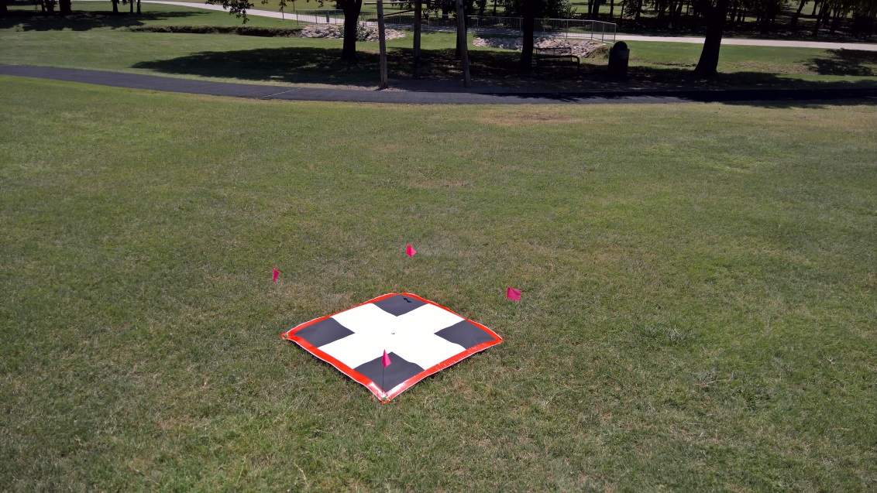
Targets are fast, easy and cheap
Sq. Meter
Reinforced Edges
Staked
Flagged
Coordinates Captured
Plotter
GPS

Slide 6
The GCPs
4 hours to plot and prep targets
8 hours to place and capture
1 hour to pick them up later

Slide 7
Mission Planning
$10 app on the Apple Store
Easy to use
Plan Flight area relative to telemetry
Battery life,
Elevation,
Wind and weather

Slide 8
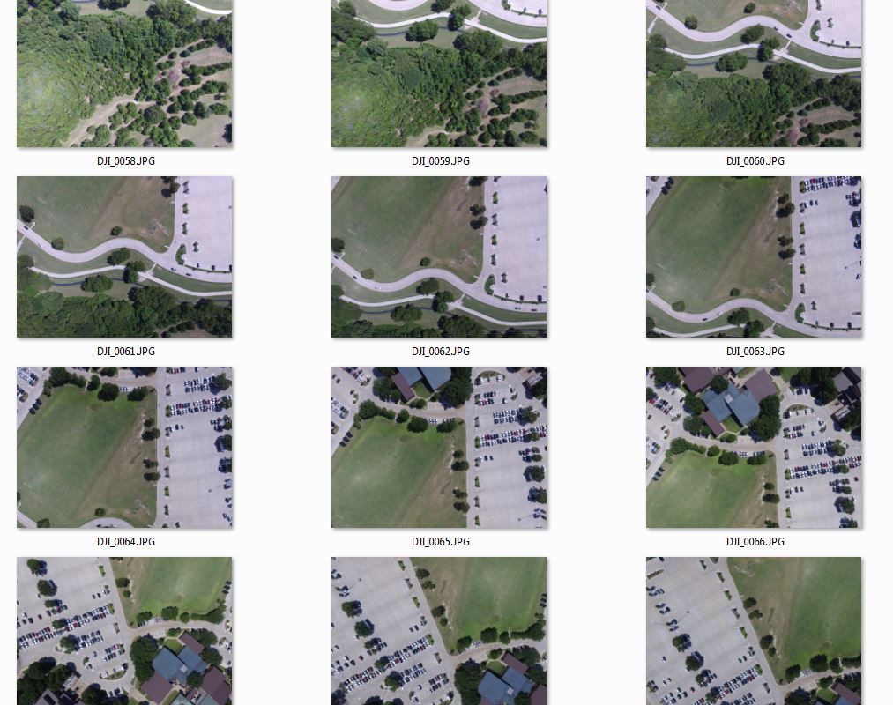
How did we cover the campus?
7 missions
400 feet elevation
Yielded 650 photos
5 member team
PIC – pilot in command
PAC – pilot at controls
VO – visual observer (3)

Slide 9
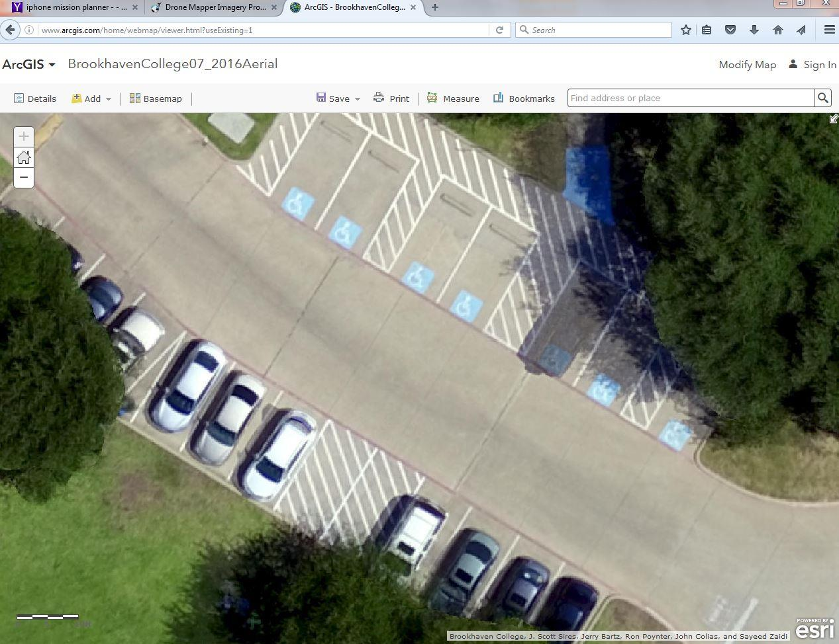
Image processing
Esri’s Drone2Map
3-hour process to stitch together 650 photos
Result is a 192 acre orthomosaic
2.25” pixel resolution
Search ‘BHC UAV’ in ArcGIS Online

Slide 11
Next Steps RE: UAS and GIS @ BHC
DIY / BYO
Hexacopter
Marine vessel
Active courses with UAS technology
Small robotics (air, land and sea)
Pre-engineering skills
Spring 2017 Festival
More course content throughout

Slide 12
UAV Workforce
Experience
Skills
Knowledge
Case Study applications

Slide 13
Evolving Research and Guidelines
FAA small UAV rules
Drone technologies as platforms
Drone sensor technology

Slide 16
Thank you
J. Scott Sires
Geospatial Technology Program
Professor & Coordinator
Brookhaven College
Mathematics & Sciences Division
3939 Valley View Lane
Bldg. H, H-115
Farmers Branch, Texas, 75244
972-860-4362
ssires@dcccd.edu www.brookhavencollege.edu/
www.dcccd.edu/gis

