Slide 1
City of Midwest City & Cityworks PLL
Use of Cityworks PLL for Code Enforcement
Notes:
Get a show of hands of how many people use Cityworks or know about Cityworks
Any PLL users?

Slide 2
Why Cityworks PLL
Current system developed in-house and lack of support from developer.
Not GIS centric, no use of GIS data or visualization.
Siloed workflow, no collaboration between officers/departments.
Not field use friendly – designed for windows boxes and not mobile.
90% of code enforcement work done in the field!
Not scalable to meet changing needs.
Notes:
11 year old system currently that has to be rewritten any time Apple updates ios.
Entries sit on individual tablets and not accessible by other officers or departments
Series of drop down fields with no visualization of where the violation is occuring

Slide 3
Why Cityworks PLL
Cityworks PLL is GIS centric.
Cityworks PLL built on workflows.
Creates transparency and collaboration between officers/departments.
Intelligent system.
Scalable.
Field work friendly (mobile native app/Respond).
Notes:
Cityworks PLL—permits, licensing and land—gives us direct control of our business processes. Designed to streamline workflows for staff, Cityworks PLL helps us deliver better service to Midwest City.
Efficiently manage the code enforcement process from documenting the violation to court appearances by the offenders.
Scalable – functional forms are highly adaptable and tailored to organizations unique structure and specific needs.
Assign code enforcement data to GIS assets like parcels or address points to keep historical records of code enforcement history

Slide 4
Cityworks PLL - Development
Partnered with Cityworks to develop system.
Code Enforcement documented day to day workflows and tasks.
Cityworks and MWC translated those to PLL workflows.
Very detailed system. I mean REALLY detailed!
Time intensive development – 10 months and just about to go live!
Notes:
30+ violation types that needed to be transferred from paper workflow diagram to PLL
Neighborhood Services Director documented these workflows.
Rewrote entire violation workflows twice during development in order to capture complete list of steps.
Violations now become managed GIS asset and can be used in various GIS applications like webmaps and dashboards.

Slide 5
Cityworks PLL
LIVE DEMO

Slide 6
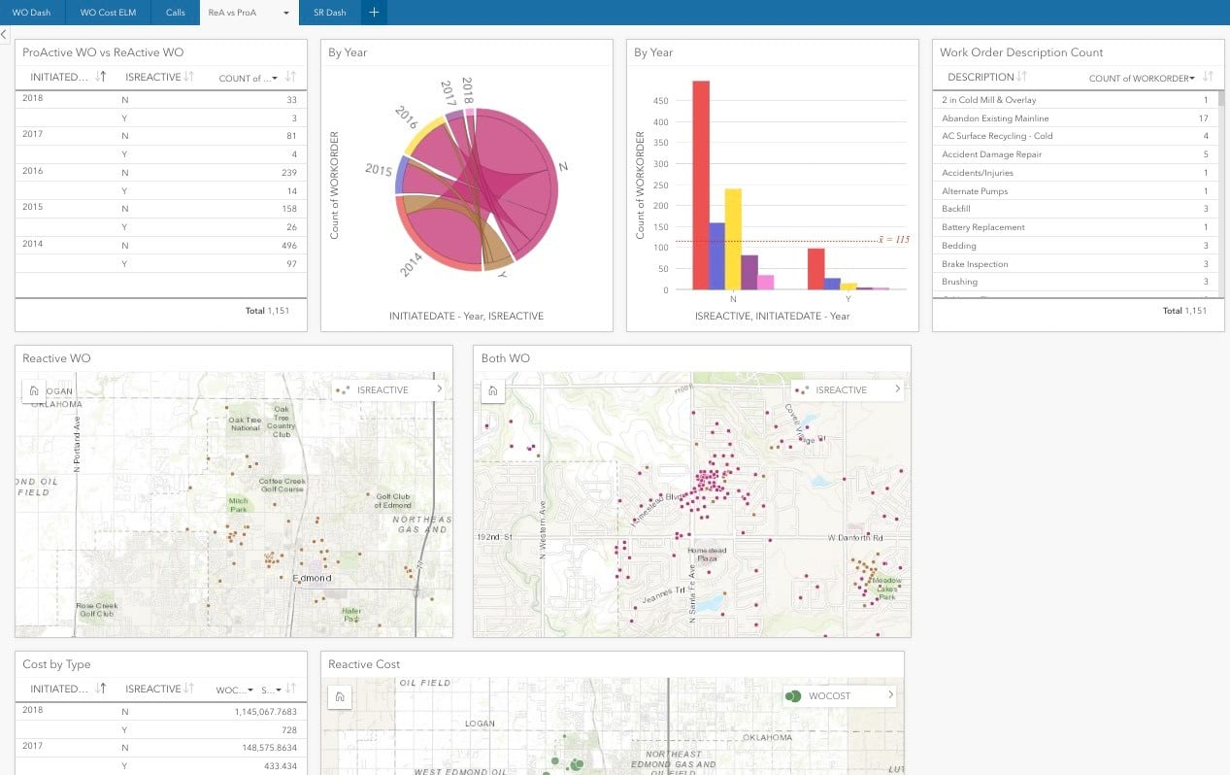
Cityworks PLL – Code Enforcement Next Steps
Notes:
Executive dashboards to give that one stop site for information about daily activities, predominant violation types being written, number of violations by officer, etc.

Slide 7
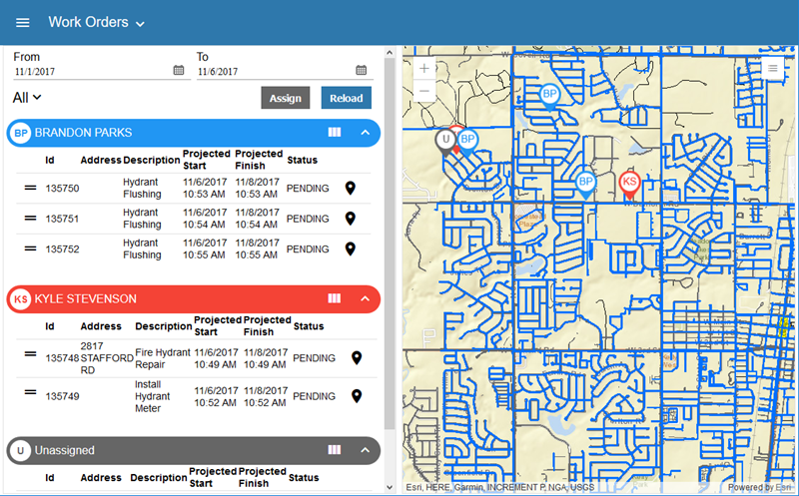
Cityworks PLL – Code Enforcement Next Steps
Notes:
Workload - For supervisors who manage field crews and inspectors, juggling employee schedules can be a daunting task. Workload gives supervisors a simple yet powerful interface for reviewing, assigning, and modifying work activities.

Slide 8
Cityworks PLL – Next Steps
Community Development integration for permits & licenses.
Public Access for direct citizen engagement.
Public Works Department
Stormwater
Fleet
Utilities
Line Crews
Street Department

Slide 9
Notes:
Limitations – front page of each had limitations on content type and quantity.
Map gallery and custom html in page description – only way to show maps

