Slide 1
Streamlining data collection and mapping with Collector and Triggers
John May, CSM, GISP
jmay@esciencesinc.com

Slide 2
ArcGIS collector
Collector is a game changer
Enables users to interact with complex data
Eliminates the learning curve
Delivers great UI
Supported on many different platforms
Extremely low cost
Massively flexible –supports drastically different work flows for the same data
Puts the data manager in control

Slide 3
ArcGIS collector
Using Collector in the field can present a few challenges
Form factor can be challenging when many fields are present.
Generally only 6 or 7 fields are viewable at a time on mobile devices.
Information to be collected may not be readily discernible.
For instance a user may not know what drainage basin they are standing in when they log a new point in a feature class.

Slide 4
Database triggers
What is a trigger?
A database trigger is procedural code that is automatically executed in response to certain events on a particular table or view in a database.
A trigger can also leverage database geometry functions.
This means you can perform geoprocessing tasks as part of a SQL statement.

Slide 5
Example 1 Auto populate data
Scenario
User is collecting information for a feature in the field
Some of the feature attributes are present in other feature classes and you don’t want to require them to examine each one for data
(example: Drainage Basins, County Boundaries)
The person in the field may not know the correct information off the top of their head

Slide 6
Example 1 solution
Simple SQL query implemented as a trigger can automatically update feature class attribute table.
SQL Example
UPDATE FeatureClassA
SET FeatureClassA.DrainageBasin = TargetFeatureClass.DrainageBasin,
FeatureClassA.County = TargetFeatureClass.County,
FeatureClassA.CountyCode = TargetFeatureClass.CountyCode,
FeatureClassA.PermitAgency = TargetFeatureClass.WMDName,
FeatureClassA.MaintenanceYard = TargetFeatureClass.MaintYard
FROM FeatureClassA
INNER JOIN TargetFeatureClass
ON FeatureClassA.shape.STWithin(TargetFeatureClass.shape) = 1
WHERE FacilityID is NULL;

Slide 7
Example 2 Auto generate names
Scenario
Feature names need to be unique and conform to a planned structure having the form of:
Base name + County Code + Numerical Sequence
Users cannot easily determine what the next available name should be

Slide 8
Example 2 solution
Simple SQL query implemented as a trigger can automatically create a feature name that conforms to a set of naming rules.
SQL Example
Update FeatureClassA set FacilityId = 'D5SWF'+ FeatureClassA.countycode + '-' + Format((NEXT Value for D5SWFSequence), '00000') where FacilityID is NULL;

Slide 9
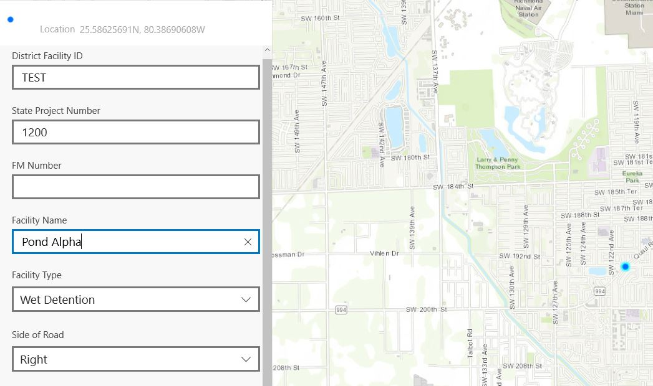
Example 2 solution
New feature

Slide 10
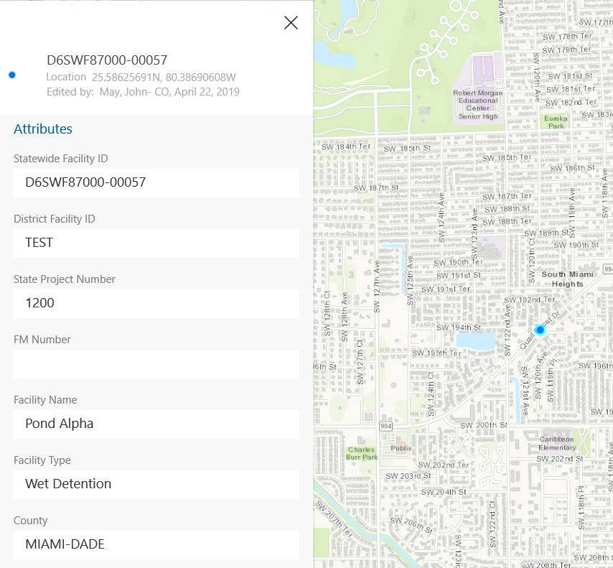
Example 2 solution
Saved data reveals information that was automatically generated by a trigger

Slide 11
Example 3 Auto generate schedules
Scenario
Features need to be inspected on a defined cycle
Each feature can have a different inspection cycle
The next inspection due is a function of when the last inspection was performed and the inspection cycle (frequency)
Users cannot easily determine when the next inspection should be performed

Slide 12
Example 3 solution
Simple SQL query implemented as a trigger on the inspection table can automatically calculate when the next inspection should be performed.
SQL Example
Update FeatureClassA Set FeatureClassA.NextInspectionDueDate = DATEADD(M, FeatureClassA.InspectionFrequency, FeatureClassA.LastInspectionDate) WHERE FeatureClassA.InspectionFrequency is NOT NULL;

Slide 13
Example 4 Auto generate Dates
Scenario
Data has to be reviewed by a manager before becoming available for use
When a record is reviewed and passed a date needs to be recorded for future use
Need to eliminate the possibility that a person would select the incorrect date

Slide 14
Example 4 solution
Simple SQL query implemented as a trigger can automatically get the current date when a record condition is changed.
SQL Example
UPDATE FeatureClassAMaintenanceNeeds set ReviewDate = GetDate() where QAStatus = 'Passed' AND ReviewDate is NULL;

Slide 15
Example 5 Auto update attributes
Scenario
Map data needs to be symbolized based on information contained in related tables
Last Inspection Date
Last Inspection Result
Last Maintenance Activity
Open Maintenance Activities
Feature
Inspection
Maintenance
Maintenance
Inspection
Maintenance

Slide 16
Example 5 solution
Simple SQL query implemented as a trigger can retrieve the desired information and store it as a feature class attribute.
SQL Example
UPDATE FeatureClassA set LastInspectionDate = C.InspectionDate, LastInspectionResult = C.InspectionResult, LastMaintenanceRequestResult = C.MaintenanceRequired
FROM FeatureClassA
INNER JOIN
(SELECT ParentGUID, FORMAT(InspectionDate,'d') AS InspectionDate, InspectionResult, MaintenanceRequired from FeatureClassInspections A
INNER JOIN
(select distinct ParentGUID as GUID, max(InspectionDate) as InspDate from FeatureClassInspections group by ParentGUID) B
on A.parentguid = B.guid and A.InspectionDate = B.Inspdate) C
ON FeatureClassA.GLOBALID = C.PARENTGUID;

Slide 17
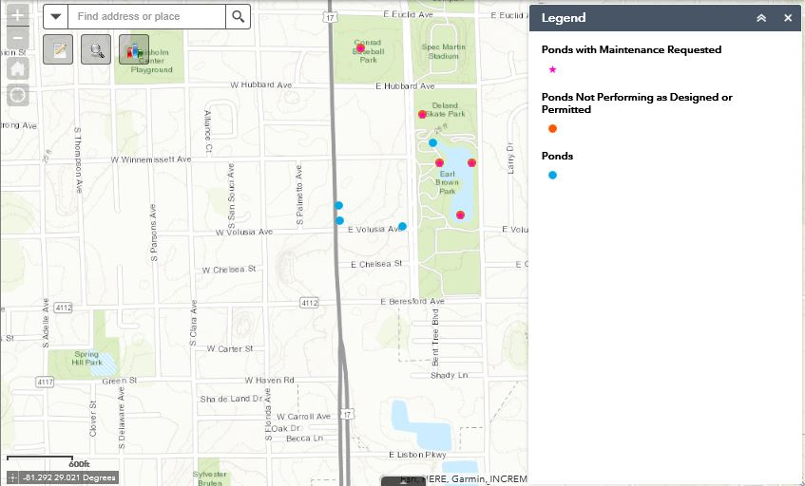
Example 5 solution

Slide 18
Example 6 Automate links to external reports
Scenario
SSRS deployed to support all reporting operations
Need a user friendly way to link reports to records

Slide 19
Example 6 solution
Simple SQL query implemented as a trigger can retrieve the desired information and store it as a feature class attribute.
SQL Example
UPDATE FeatureClass set rptFacility = 'http://dcs-abc-dec11/RptSrvr_SSRSPROD?/FOLDER/FacRpt&rs:Command=Render&GUID=' + cast(globalid as varchar(36))
WHERE rptFacility is NULL;

Slide 20
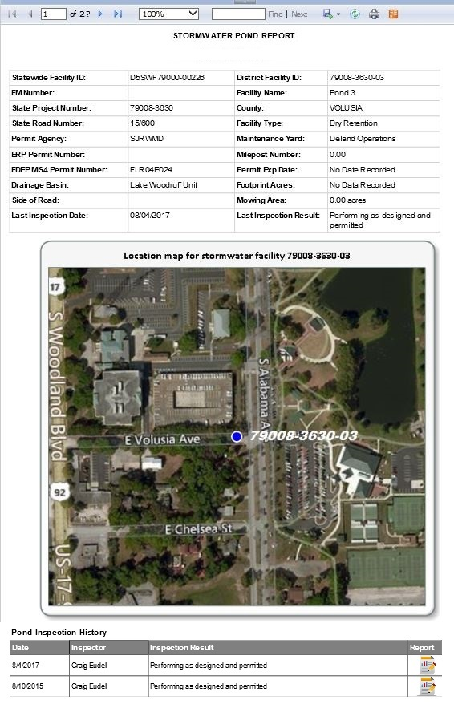
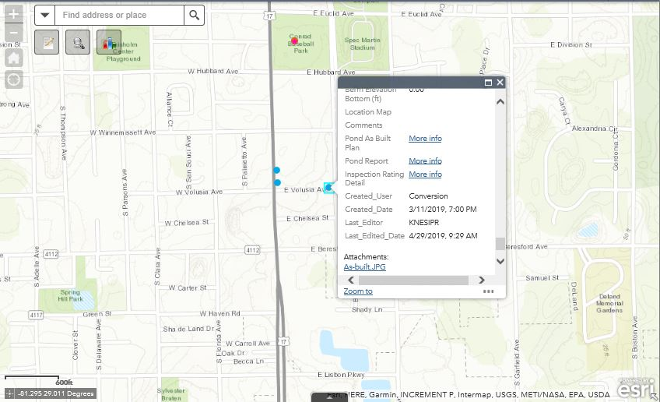
Example 6 solution

Slide 21
other StGeometry Functions
Additional Scenarios
Is a point is within a buffered area
Is a point is within a distance of a feature
Does a line intersect another line or polygon
Does a feature fall completely within a polygon
Generate centroid values
Generate XY coordinates
Does a geometry touch another geometry
Union objects into a single result

Slide 22
resources
ESRI Resource URL for STGeometry Functions
http://desktop.arcgis.com/en/arcmap/latest/manage-data/using-sql-with-gdbs/a-quick-tour-of-sql-functions-used-with-st-geometry.htm
Microsoft Resource URL
https://docs.microsoft.com/en-us/sql/t-sql/spatial-geometry/ogc-methods-on-geometry-instances?view=sql-server-2017

