Slide 1
Aiding Natural Disaster Response:
Regularly Updating Storm Shelter Registrations through Automation
Kevin Gustavson, Ph.D., Information Technology
OKSCAUG Conference – September 2019

Slide 2
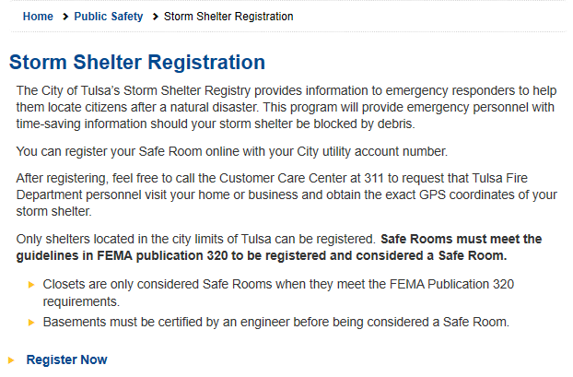
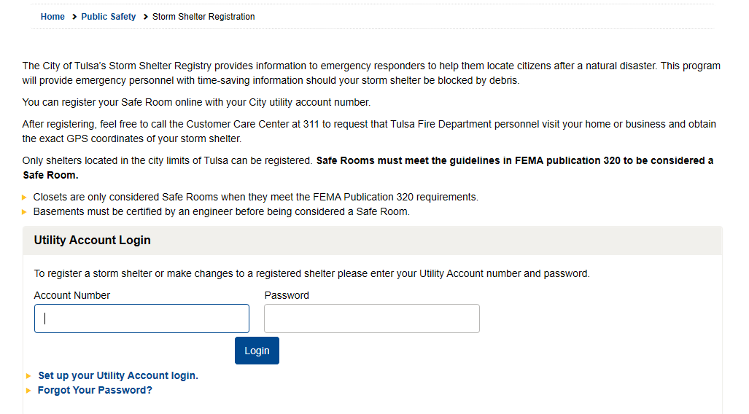
Tulsa Storm Shelter Registration Website
City Residents can register their storm shelters on City website →
Call Customer Care Center to have Fire Dept get exact GPS coordinates of shelter.
https://www.cityoftulsa.org/residents/public-safety/storm-shelter-registration/

Slide 3
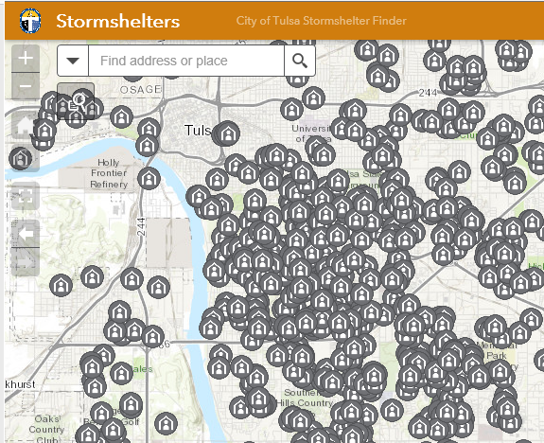
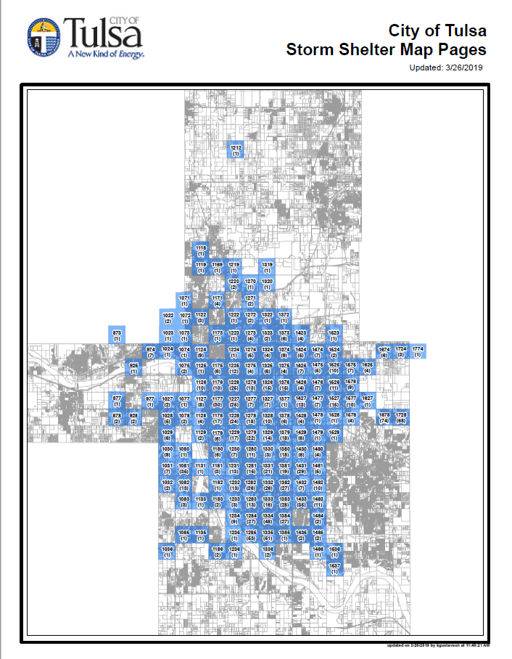
GIS Group → Annual update
Each Spring
Update storm shelter feature class (geocode addresses)
→ updates web map
Create a map book (used as back-up)

Slide 4
Storm Shelter Web Map (internal)
Owner Name
Full Address
Description
Operational Days
Operational Hours
Contact Name
Phone
Email
Dimensions
Capacity
Latitude
Longitude

Slide 5
Storm Shelter Map Book
Cover Page with:
Fire Map Number
Number of Storm Shelters
Only display maps with shelters

Slide 6
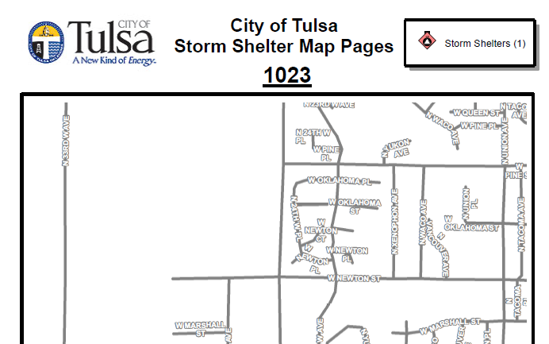
Storm Shelter Map Book
Example Fire Map
Shelter Location
Address call-outs
Data Driven Pages
Only showing a partial page: Not allowed to show specific locations…

Slide 7
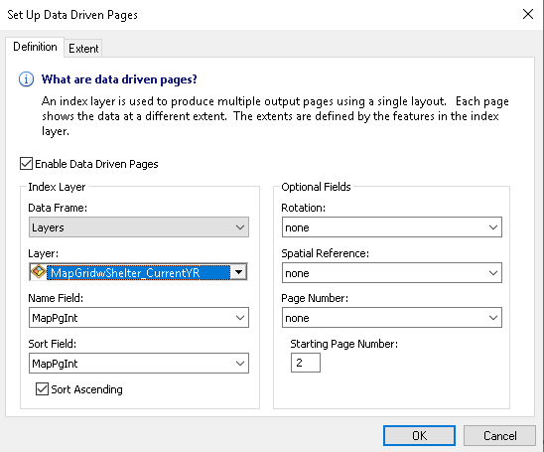
Storm Shelter Map Book
Data Driven Pages
Creates a map page for each polygon in the selected feature class.
Displays and sorts on the same field (map page number)
Export to pdf

Slide 8
Employee who did this in the past: left the city
Got an annual reminder (Service Desk) to update the storm shelter maps.
Messy process of finding out:
What was done in past?
Where the latest mxd is located?
Where is the data to fix broken connections?
What was done to create the various layers?
Where did the shelter registration data come from?
etc.
Why go though this every year??? → Automate

Slide 9
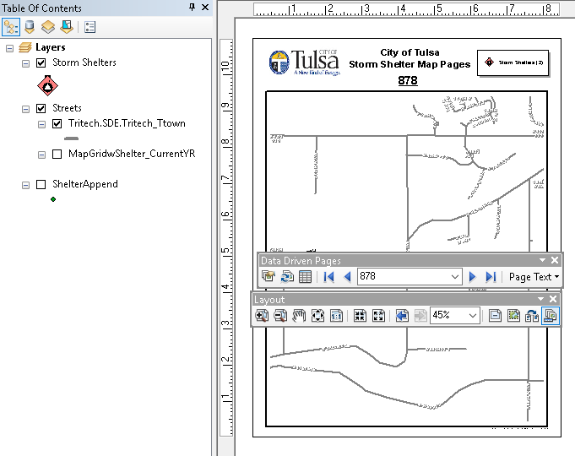
Set up Map Pages Layout in one mxd
*Storm Shelters → all shelters
Streets
*Fire map pages with shelters (for data driven pages)
*New shelters (ShelterAppend) – not needed on map
*Updating needed

Slide 10
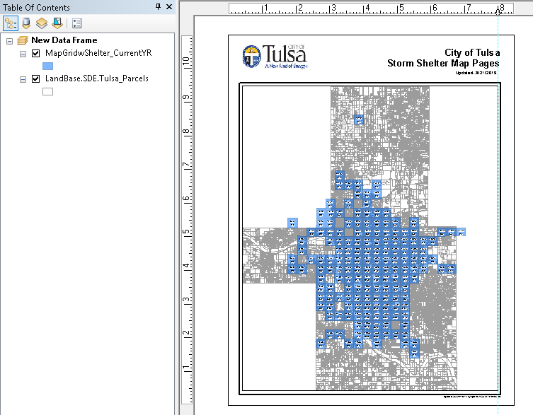
Set up Cover Page Layout in another mxd
Fire map pages (w/ shelters)
Tulsa County Parcels

Slide 11
Automation Work Flow (Update Storm Shelters)
SQL Database View (Table of StormShelters)
“ShelterTable”
Compare to addresses in shelter feature class
Convert
Select all geocoded points with status “M” (match) and address not in SDE
“Appendfc”
Table in Geodatabase
“GeoTable”
Append new shelters to shelter feature class
“ShelterSDE”
Geocode
“Geofc”

Slide 12
Automation Work Flow (Update Map Pages)
Fire Map Pages
“FireMaps”
Select all maps that have storm shelters in them
“CurrentMapfc”
Store the number of shelters for each page in new field

Slide 13
Start the Script
Import arcpy – access to all the ArGIS geoprocessing
Set workspace – where files will be saved or accessed by default

Slide 14
Inputs and Outputs
Define location of all inputs and outputs
Delete old files that you want to overwrite with new files

Slide 15
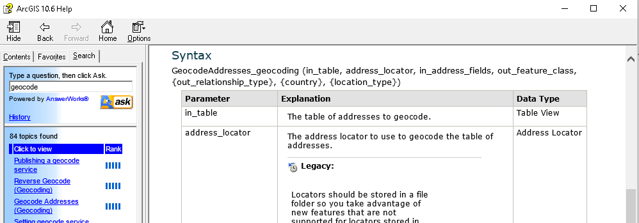
Geocode
Convert SQL View to Geodatabase table (“GeoTable”)
Geocode the Geodatabase table → create “Geofc”

Slide 16
Start Editing
3rd Workspace – uses connection credentials set up in ArcCatalog (specific to computer script runs on)
startEditing (with_undo, multiuser_mode)
(False = without undo, True = edits will be committed)

Slide 17
Read in all the addresses currently in SDE
Runs through each existing storm shelter and appends the address to a Python list “ShelterList”.

Slide 18
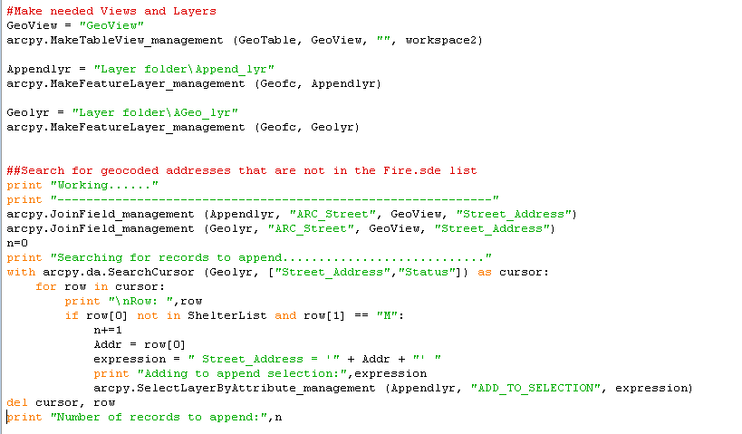
Find the New Addresses
Shelter table
Shelter table
Geocode result

Slide 19
Append the New Records to SDE and Stop Editing

Slide 20
Select Only Maps that Contain Shelters
→ Save off as a new feature class with “CopyFeatures_management”

Slide 21
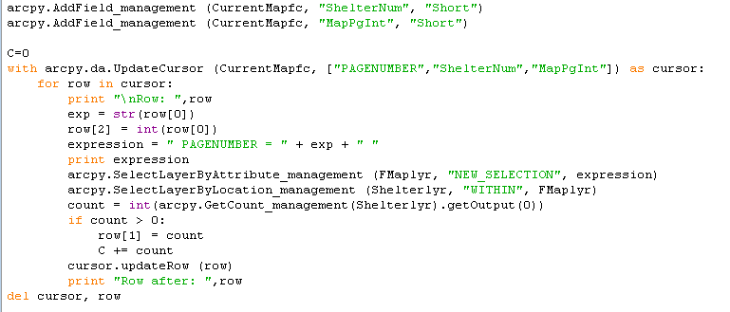
Record the Number of Shelters on Each Map Page
-Select polygons with
shelters within -Count them
-Store count in field

Slide 22
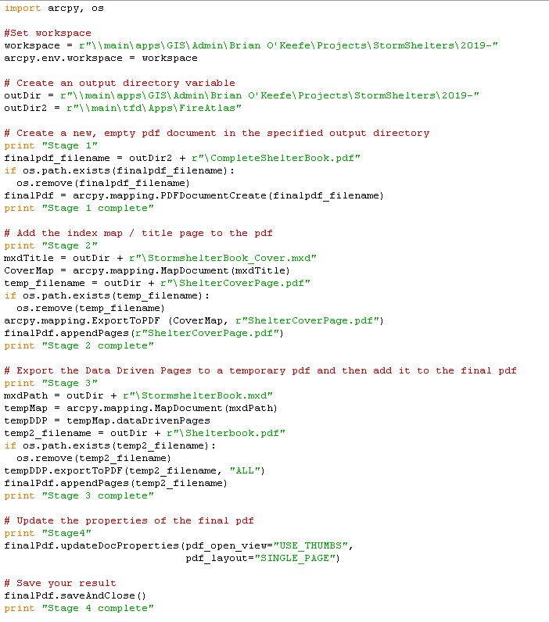
Create Map Book pdf
Create empty pdf
“CompleteShelterBook.pdf”
Create title page pdf and add to book
“ShelterCoverPage.pdf”
Export map pages to pdf and add to book
“Shelterbook.pdf”
Update properties of final pdf

Slide 23
Contacted Fire Department
Updates no longer have to be annual…
Where do they want the map book?
How often do they want them updated?
Found out:
Mapbooks are backups (they use Computer-aided Dispatch system (CAD))
Initially →monthly updates.
Later → weekly
Could we send them the weekly changes…to keep their CAD up-to-date?

Slide 24
Weekly Updates
Added 3 lines of code to script:
create feature class of Appended shelters (if any new)
Also path to “Append” file and delete old Append file
Co-worker was going to look for the file each week and send to Fire Dept.
But why go through all that trouble?
→ wrote a script to send the email

Slide 25
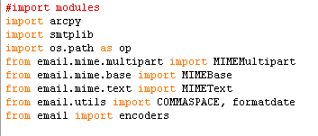
Send Email Script
Import all the needed Python modules
Set workspace

Slide 26
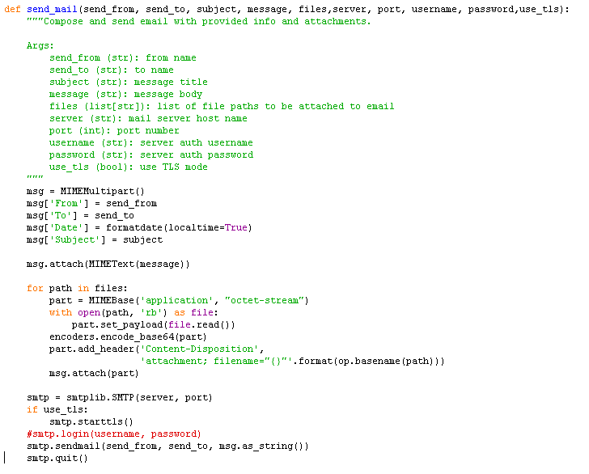
Send Email – function called to send the email
This function is called from the main body.
With all of the “arguments” on the first line, this code sends mail with attachments.

Slide 27
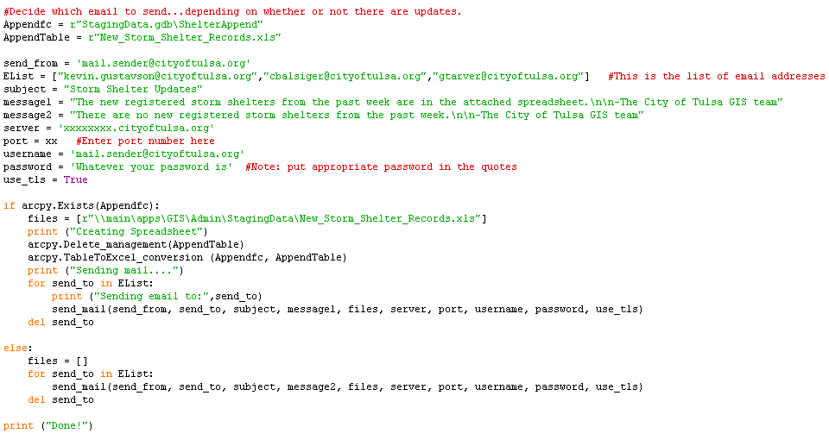
Send Email – main body
If “Appendfc” exists, send attachment…if not...no attachment

Slide 28
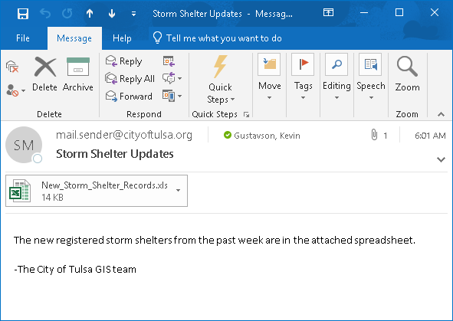
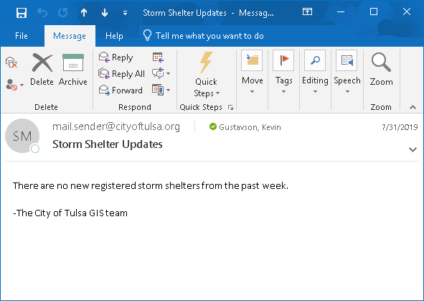
Send Email – result
Set up all 3 scripts to run on Task Scheduler: weekly email!!

Slide 29
Learn Python
ArcGIS Online tutorials – “Python for Everyone”
DataCamp Codecademy
datacamp.com codecademy.com

Slide 30
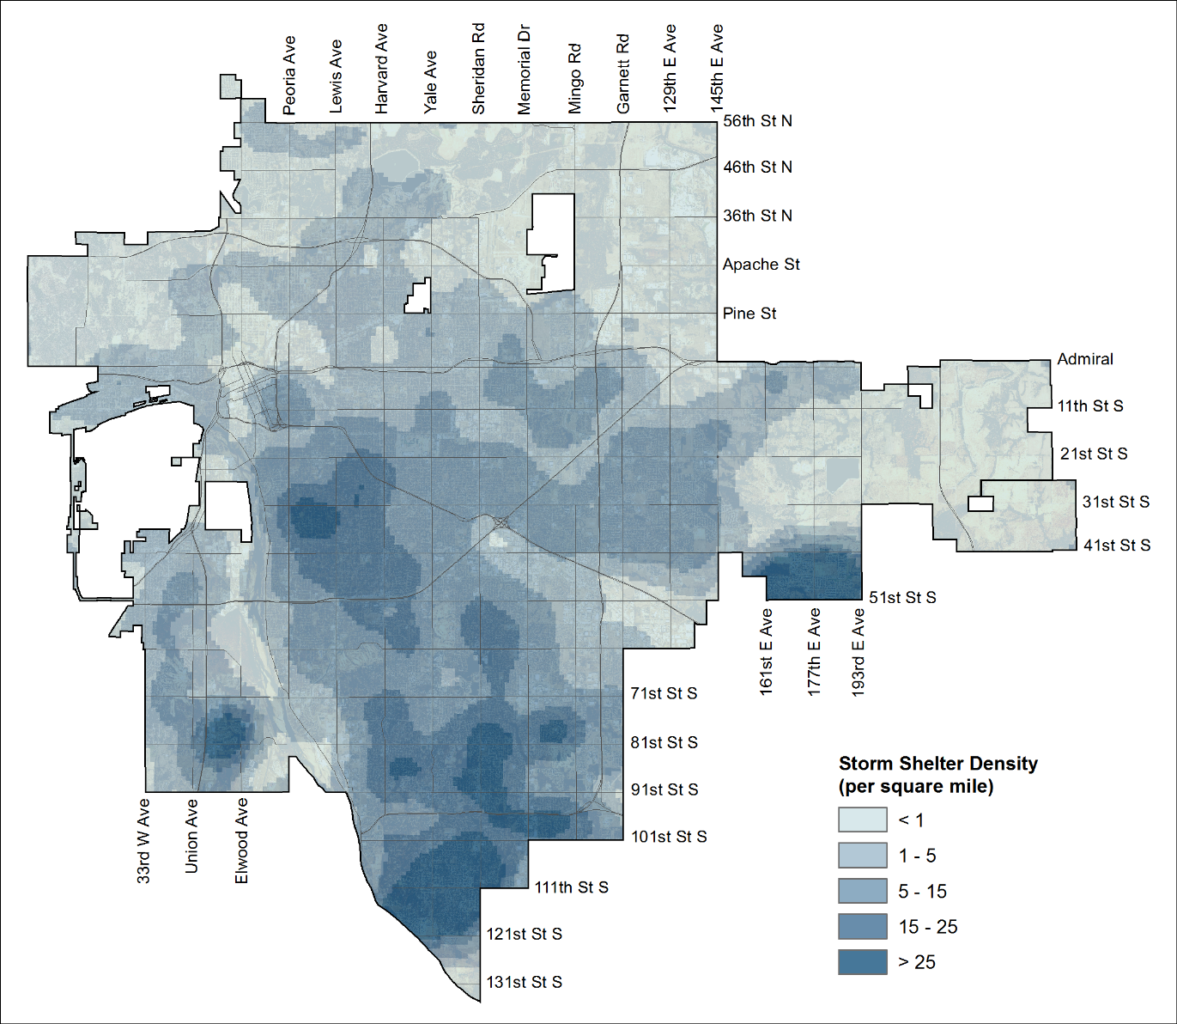
Displaying Sensitive Information in Maps
Check out Alana Kleven’s poster!!

