Slide 1
Bringing the Dashboard Out of the Vehicle
Creating Dashboards at ODOT
Oklahoma Department of Transportation
Gwen Johnson and Devin Hargus

Slide 2
About ODOT

Slide 3
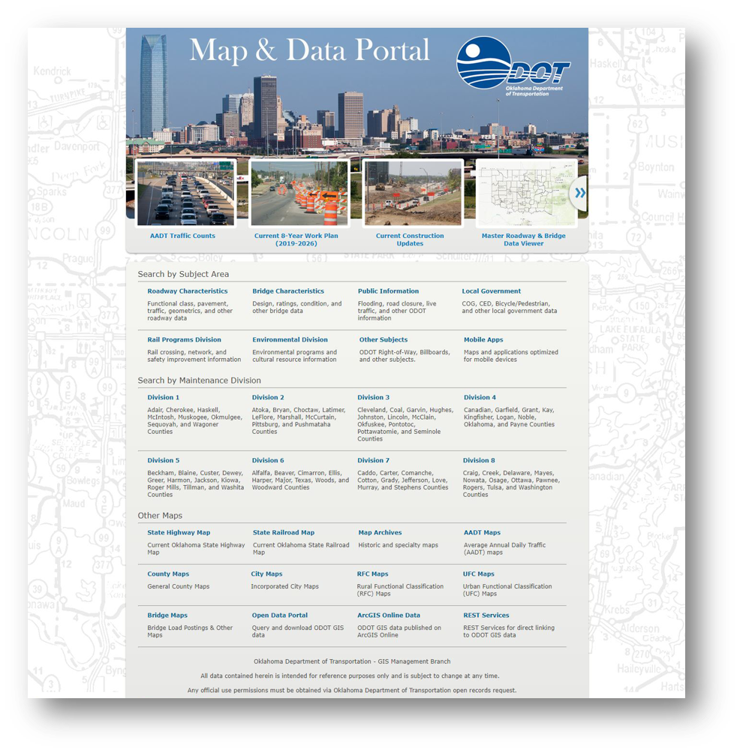
GIS at ODOT
Road Inventory
Maintain statewide roadway network
Report to Federal Highway Administration
Report to Oklahoma Tax Commission
GIS Management
Maintains all other statewide data
Mapping Requests

Slide 4
County Certification Dashboard

Slide 5
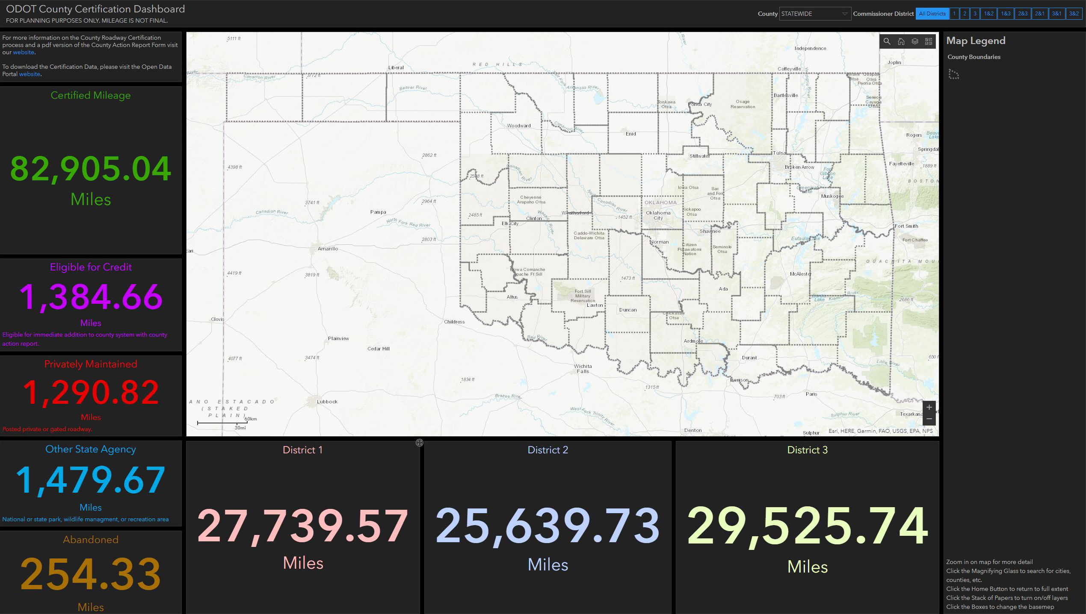
County Certification Dashboard
History
Phone Calls
Webmap
Informative
Too confusing for non-GIS Users
Not able to single out individual counties
Wanted some mileage summaries
Association of County Commissioners of Oklahoma (ACCO) Conference
Realizing a need for a Dashboard
A one stop shop for the County Commissioners
Final
Dashboard
Link

Slide 6
MAPS-21 Performance Measures Dashboards

Slide 7
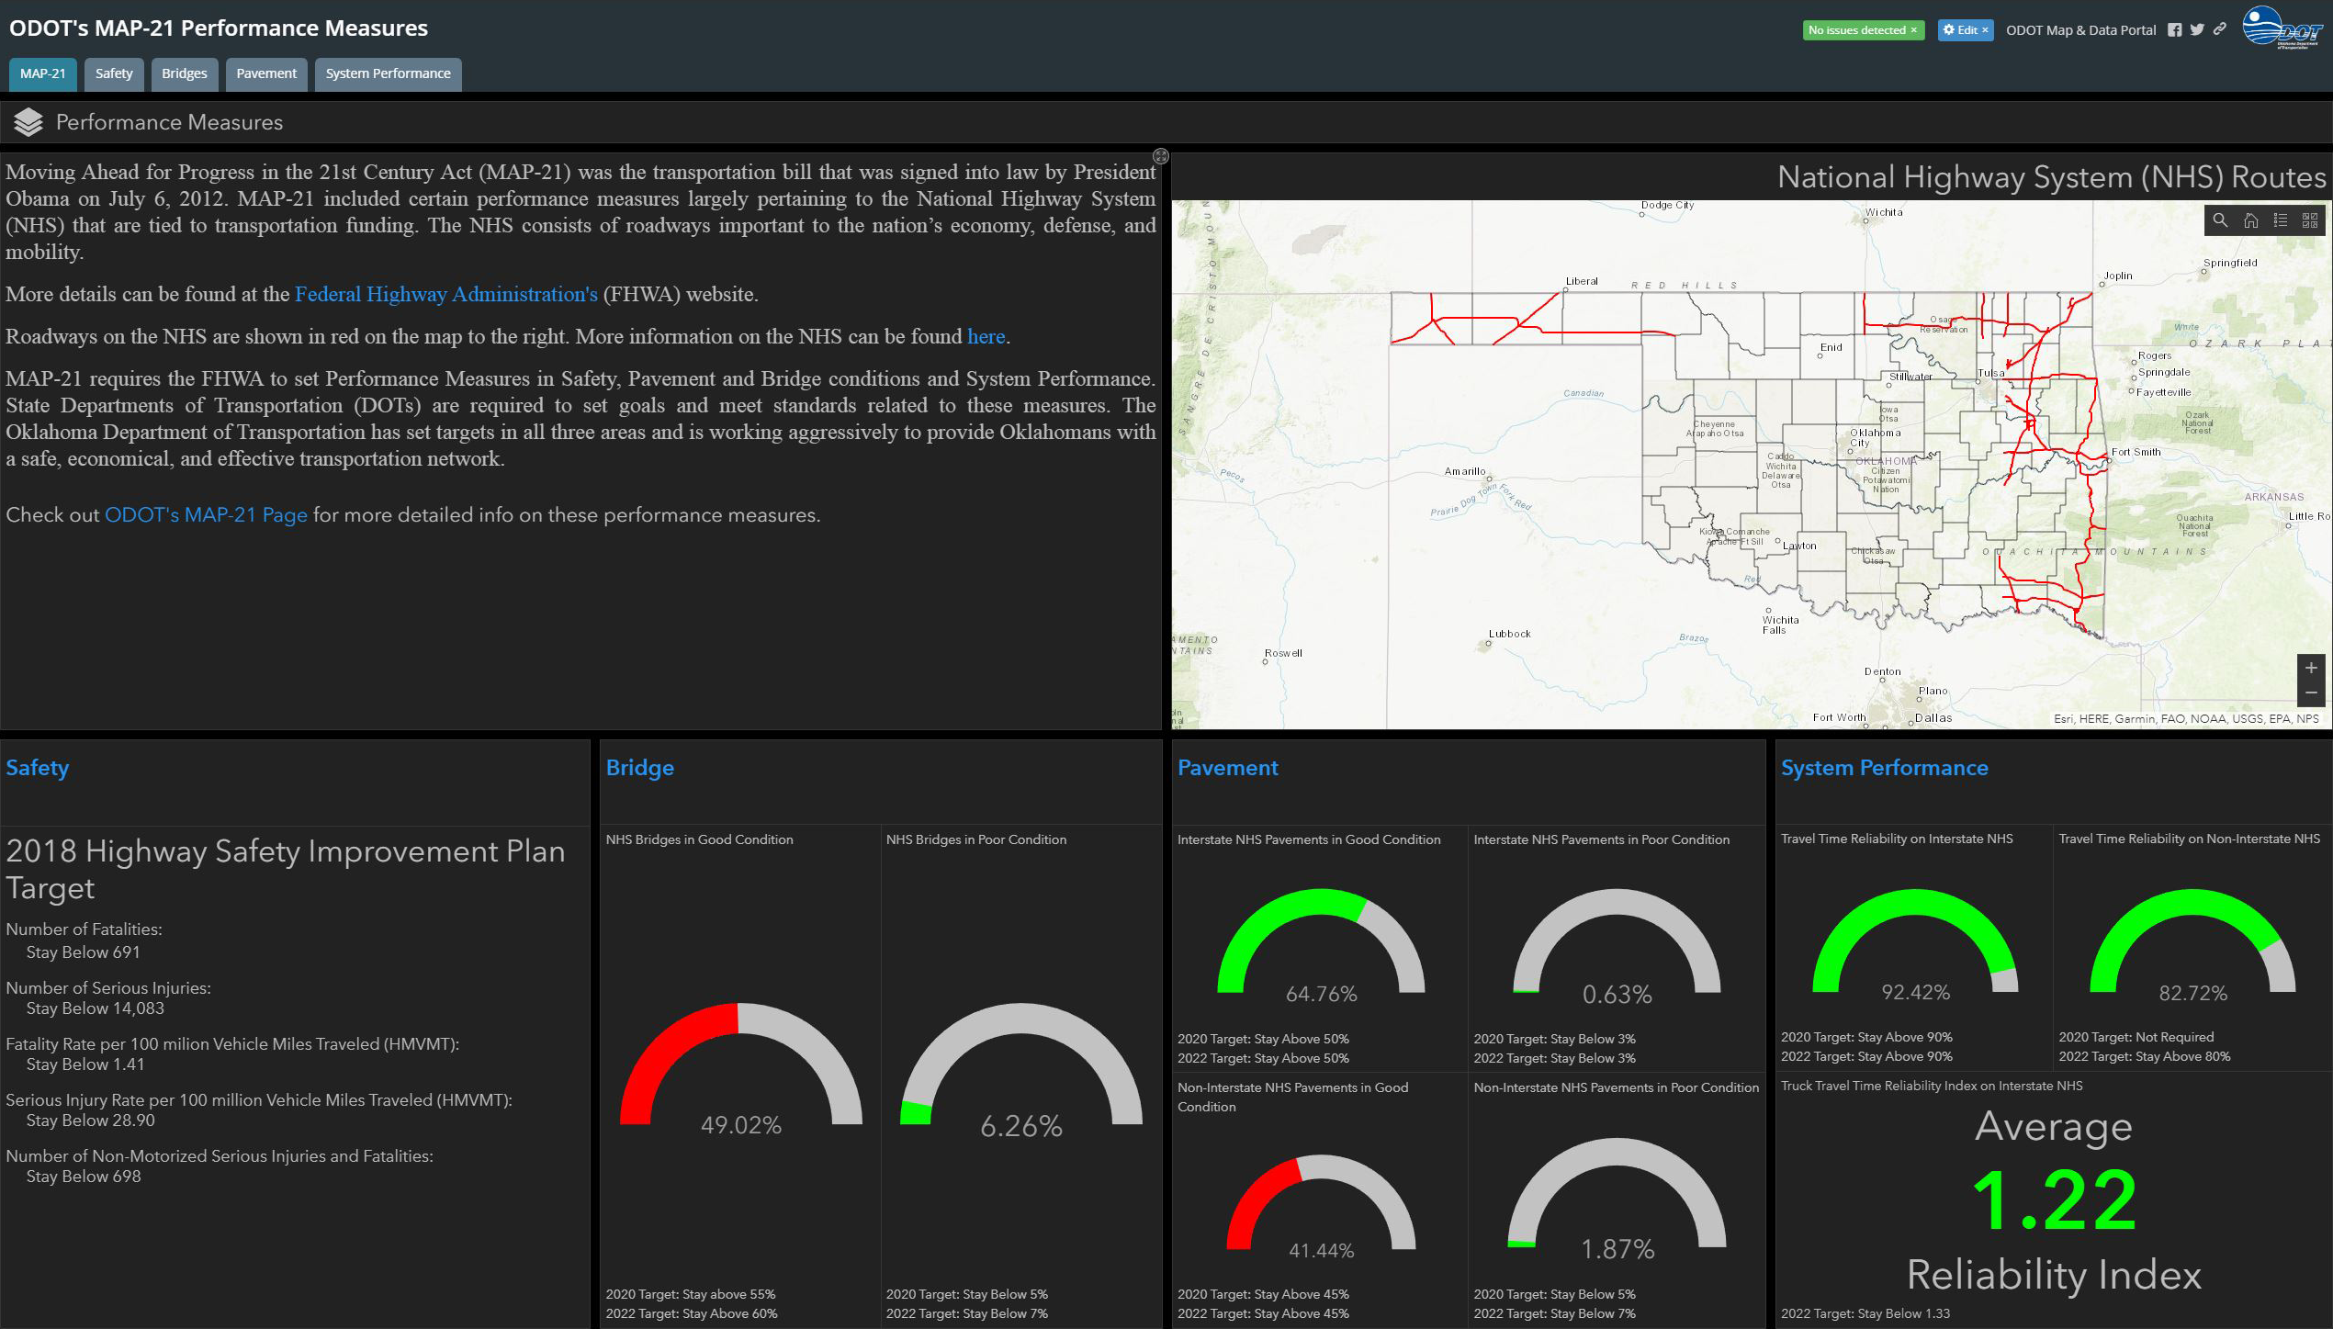
MAPS-21 Performance Measures Dashboards
History
6-page report of targets
Research
How are other states showing their Performance Measures?
Virginia, Alaska, Minnesota, Washington State, Kane County, IL
Oklahoma Department Public Safety
Final
Dashboard
Story Map
Website
Link

Slide 8
Elements of a Dashboard

Slide 9
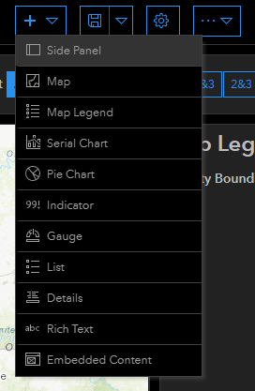
Elements of a Dashboard
Webmap Setup
Header
Side Panel
Legend
Charts and Graphs
Serial
Pie
Gauge
Indicator
List
Details
Rich Text
Embedded Content

Slide 10
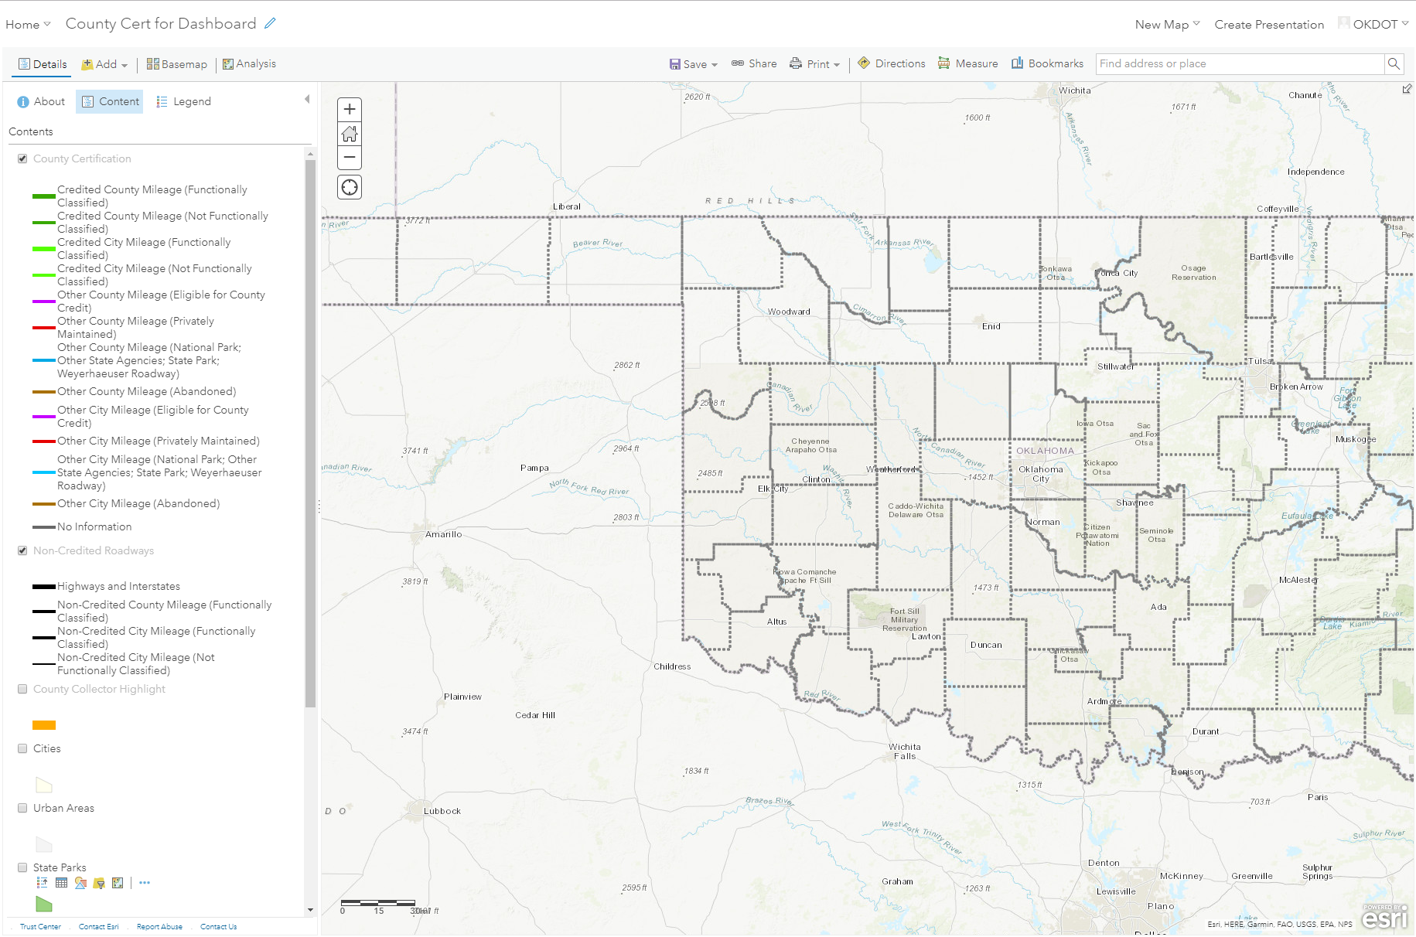
Elements of a Dashboard
Webmap Setup
Header
Side Panel
Legend
Charts and Graphs
Serial
Pie
Gauge
Indicator
List
Details
Rich Text
Embedded Content

Slide 11
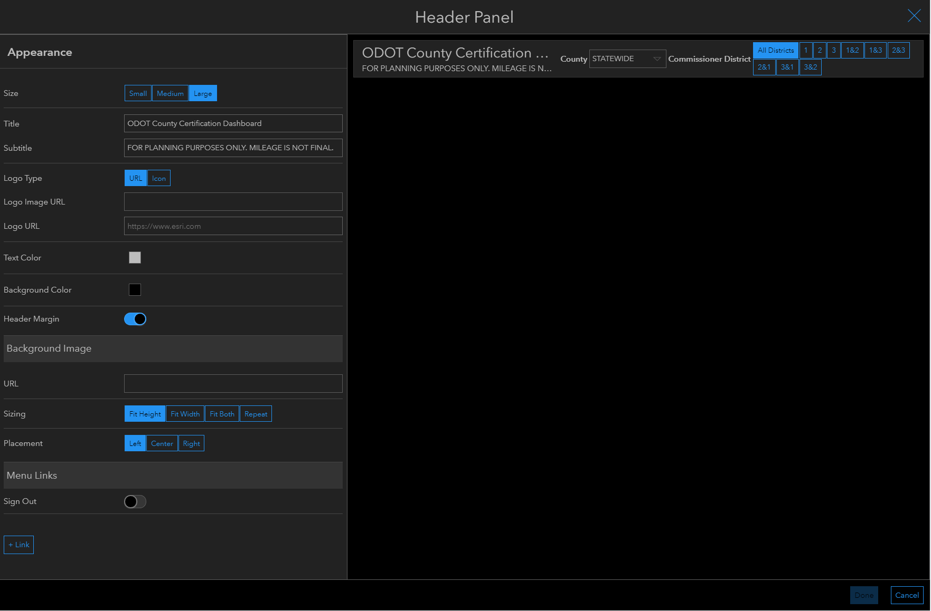
Elements of a Dashboard
Webmap Setup
Header
Side Panel
Legend
Charts and Graphs
Serial
Pie
Gauge
Indicator
List
Details
Rich Text
Embedded Content

Slide 12
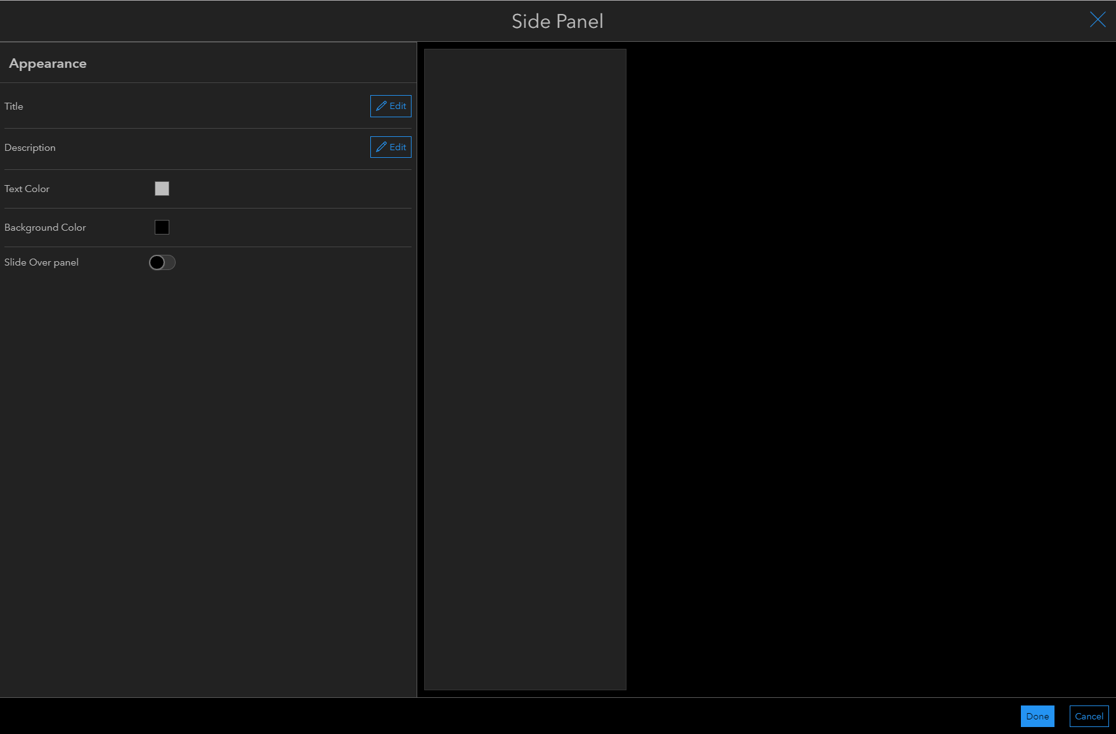
Elements of a Dashboard
Webmap Setup
Header
Side Panel
Legend
Charts and Graphs
Serial
Pie
Gauge
Indicator
List
Details
Rich Text
Embedded Content

Slide 13
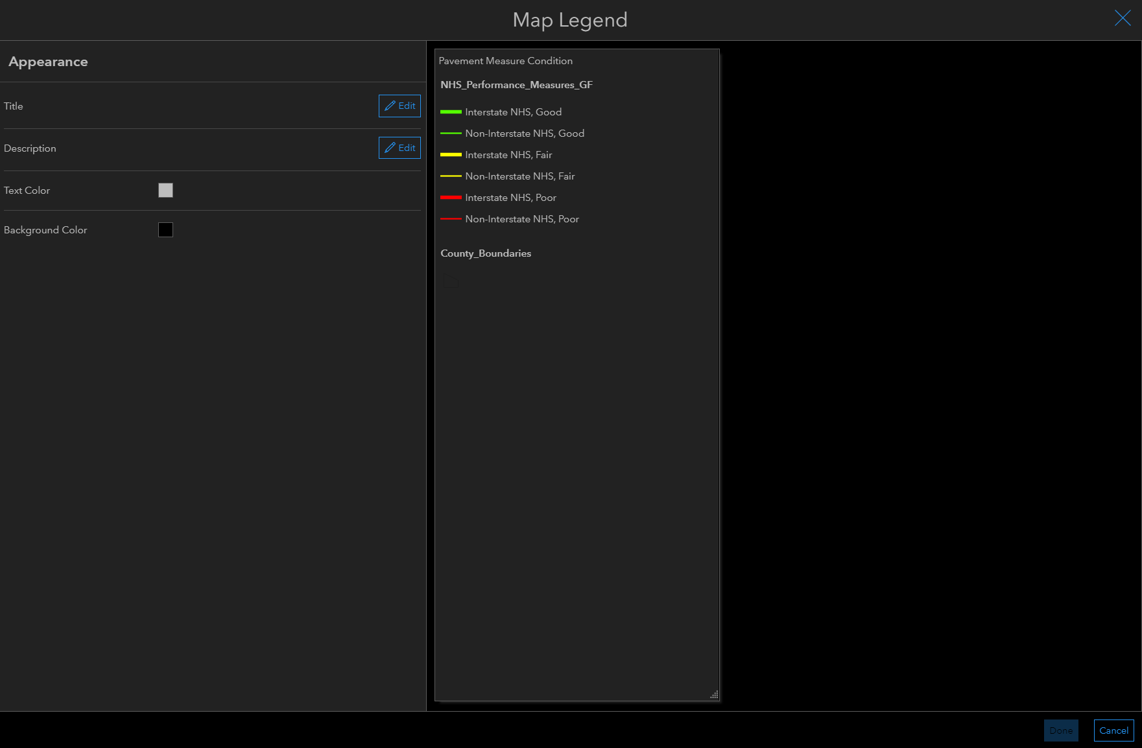
Elements of a Dashboard
Webmap Setup
Header
Side Panel
Legend
Charts and Graphs
Serial
Pie
Gauge
Indicator
List
Details
Rich Text
Embedded Content

Slide 14
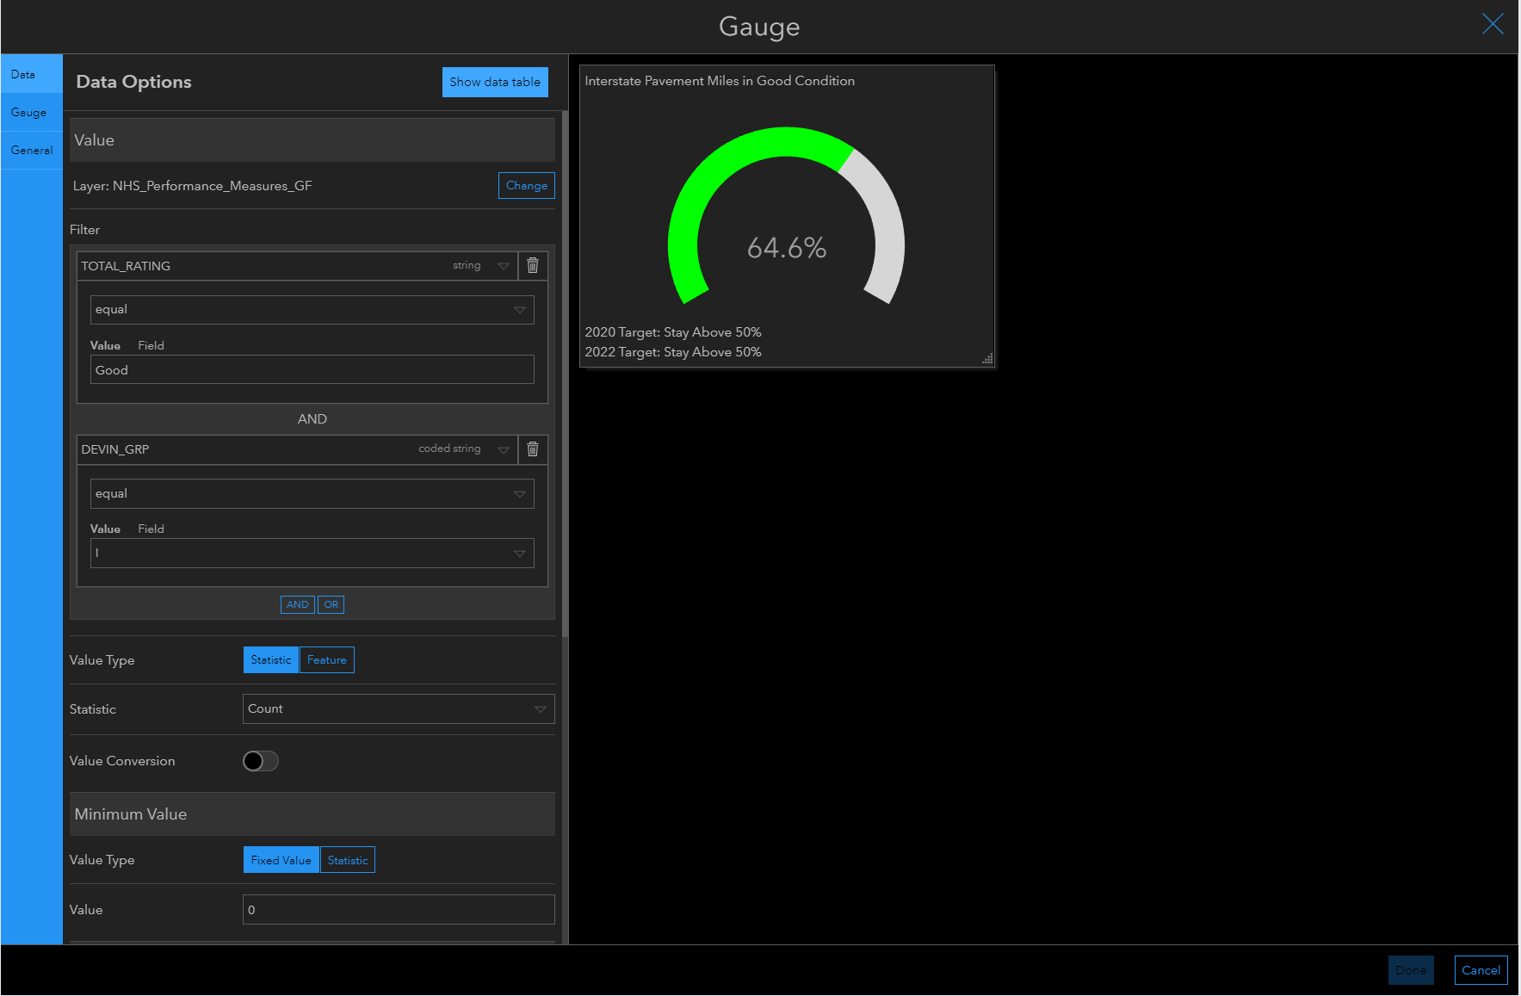
Elements of a Dashboard
Webmap Setup
Header
Side Panel
Legend
Charts and Graphs
Serial
Pie
Gauge
Indicator
List
Details
Rich Text
Embedded Content

Slide 15
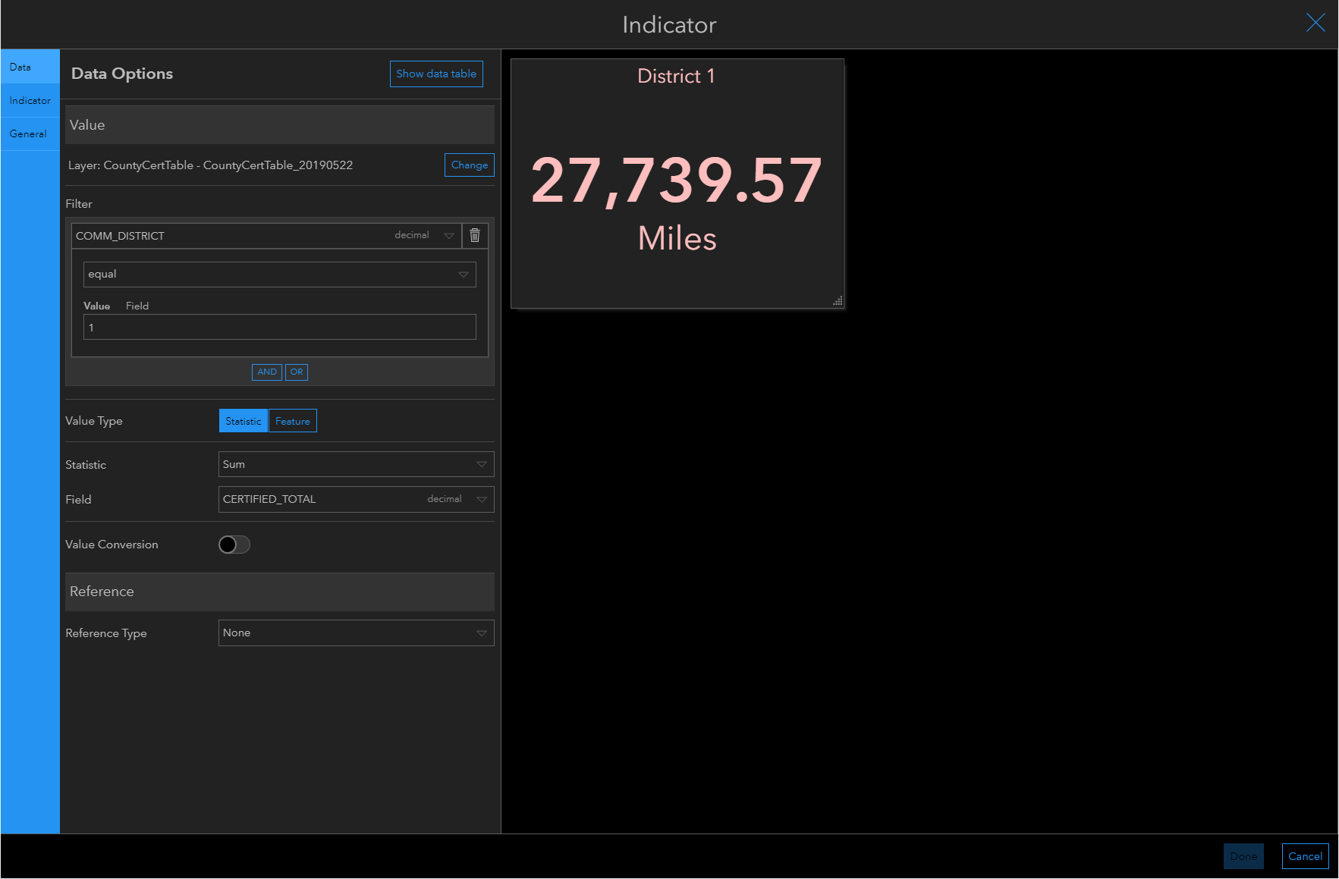
Elements of a Dashboard
Webmap Setup
Header
Side Panel
Legend
Charts and Graphs
Serial
Pie
Gauge
Indicator
List
Details
Rich Text
Embedded Content

Slide 16
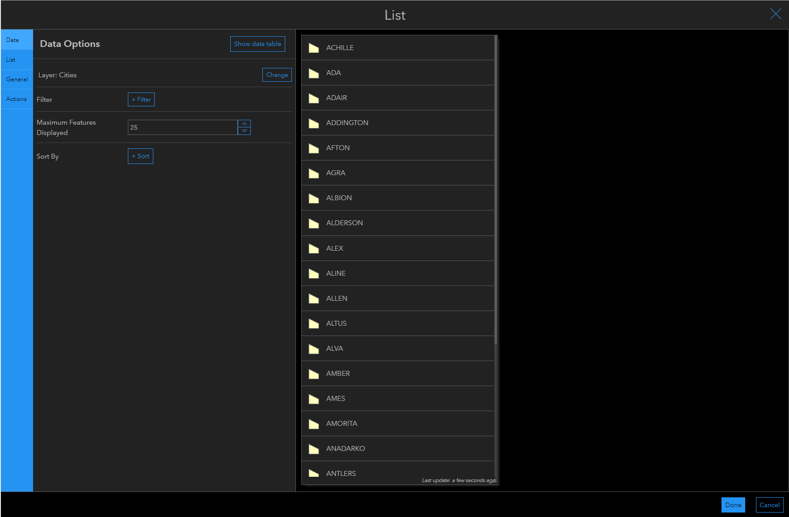
Elements of a Dashboard
Webmap Setup
Header
Side Panel
Legend
Charts and Graphs
Serial
Pie
Gauge
Indicator
List
Details
Rich Text
Embedded Content

Slide 17
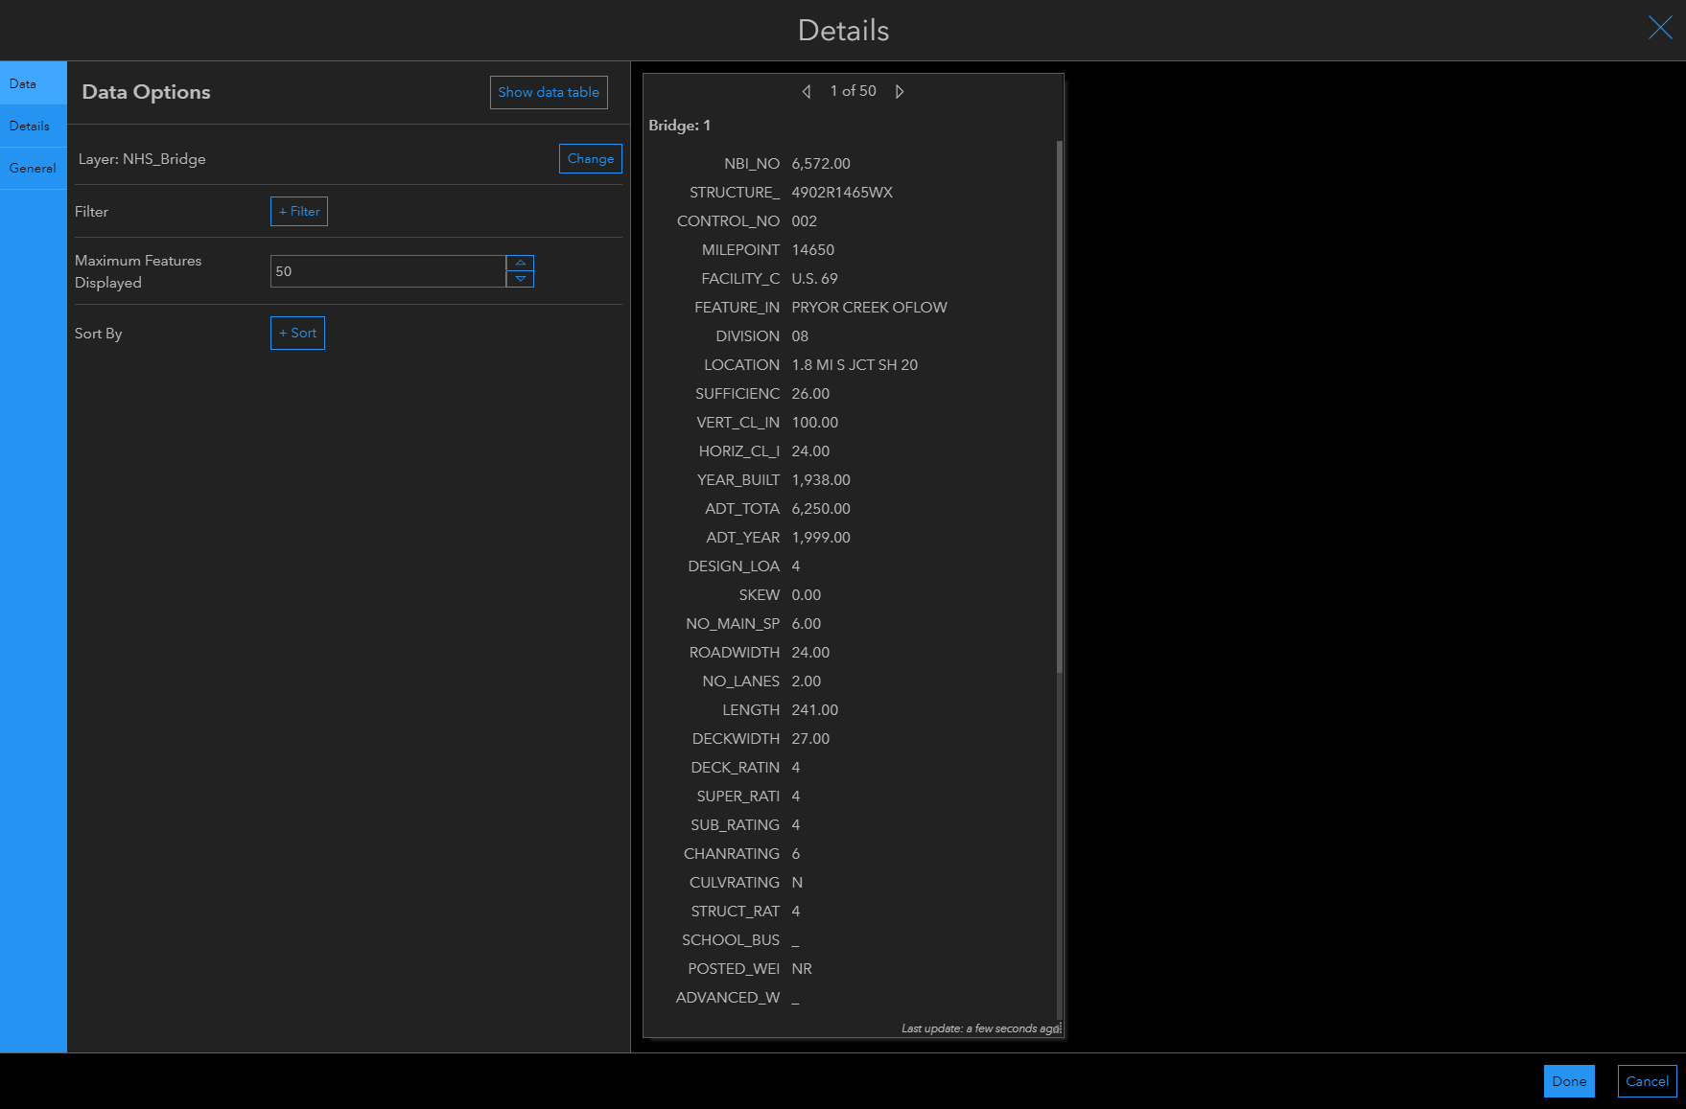
Elements of a Dashboard
Webmap Setup
Header
Side Panel
Legend
Charts and Graphs
Serial
Pie
Gauge
Indicator
List
Details
Rich Text
Embedded Content

Slide 18
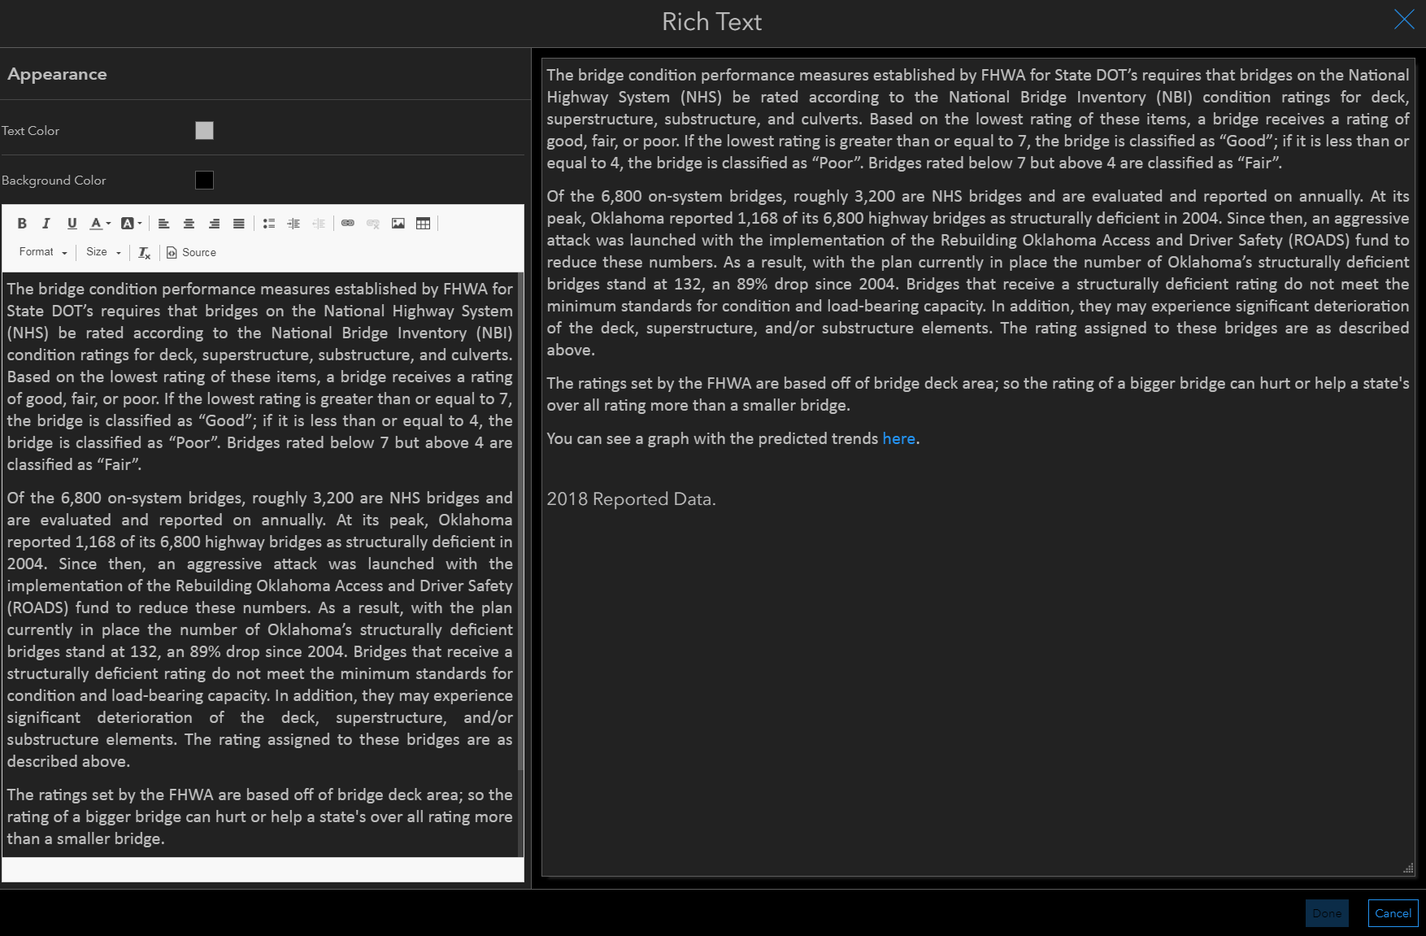
Elements of a Dashboard
Webmap Setup
Header
Side Panel
Legend
Charts and Graphs
Serial
Pie
Gauge
Indicator
List
Details
Rich Text
Embedded Content

Slide 19
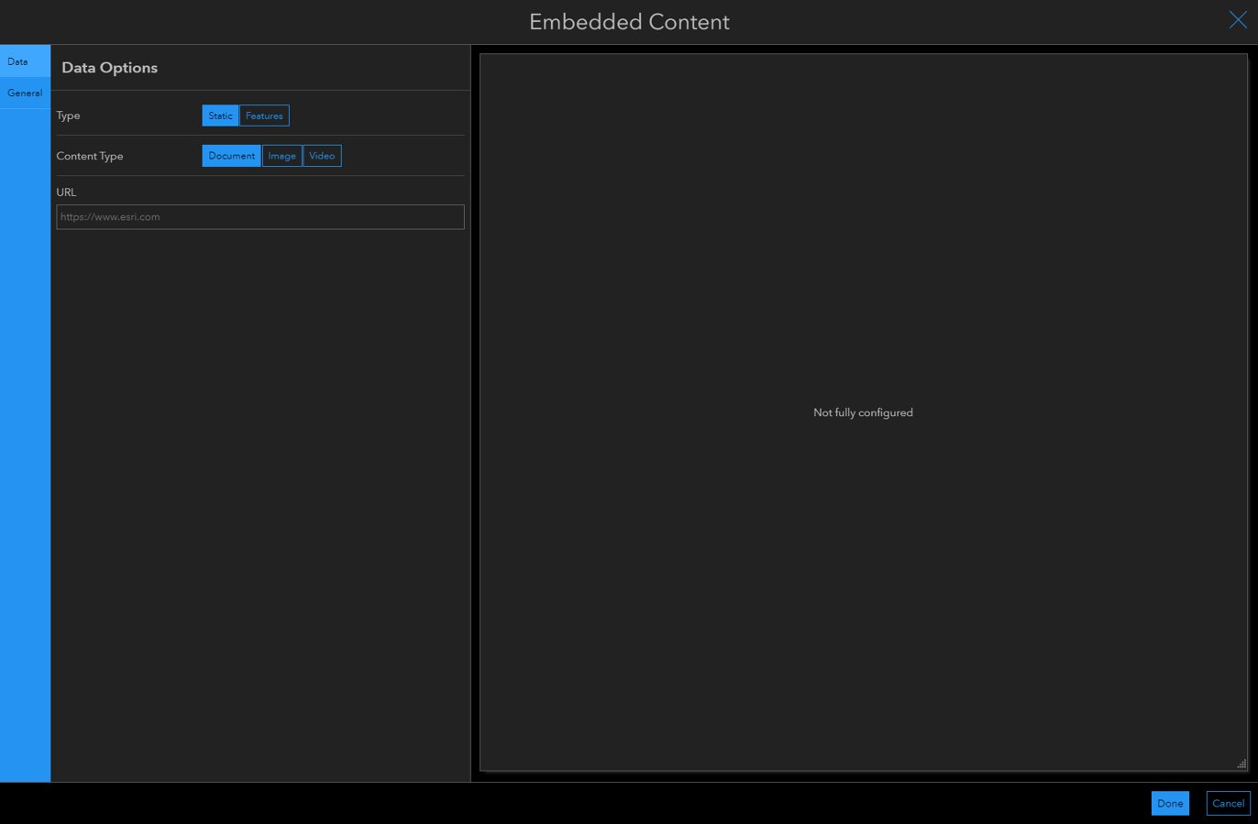
Elements of a Dashboard
Webmap Setup
Header
Side Panel
Legend
Charts and Graphs
Serial
Pie
Gauge
Indicator
List
Details
Rich Text
Embedded Content

Slide 20
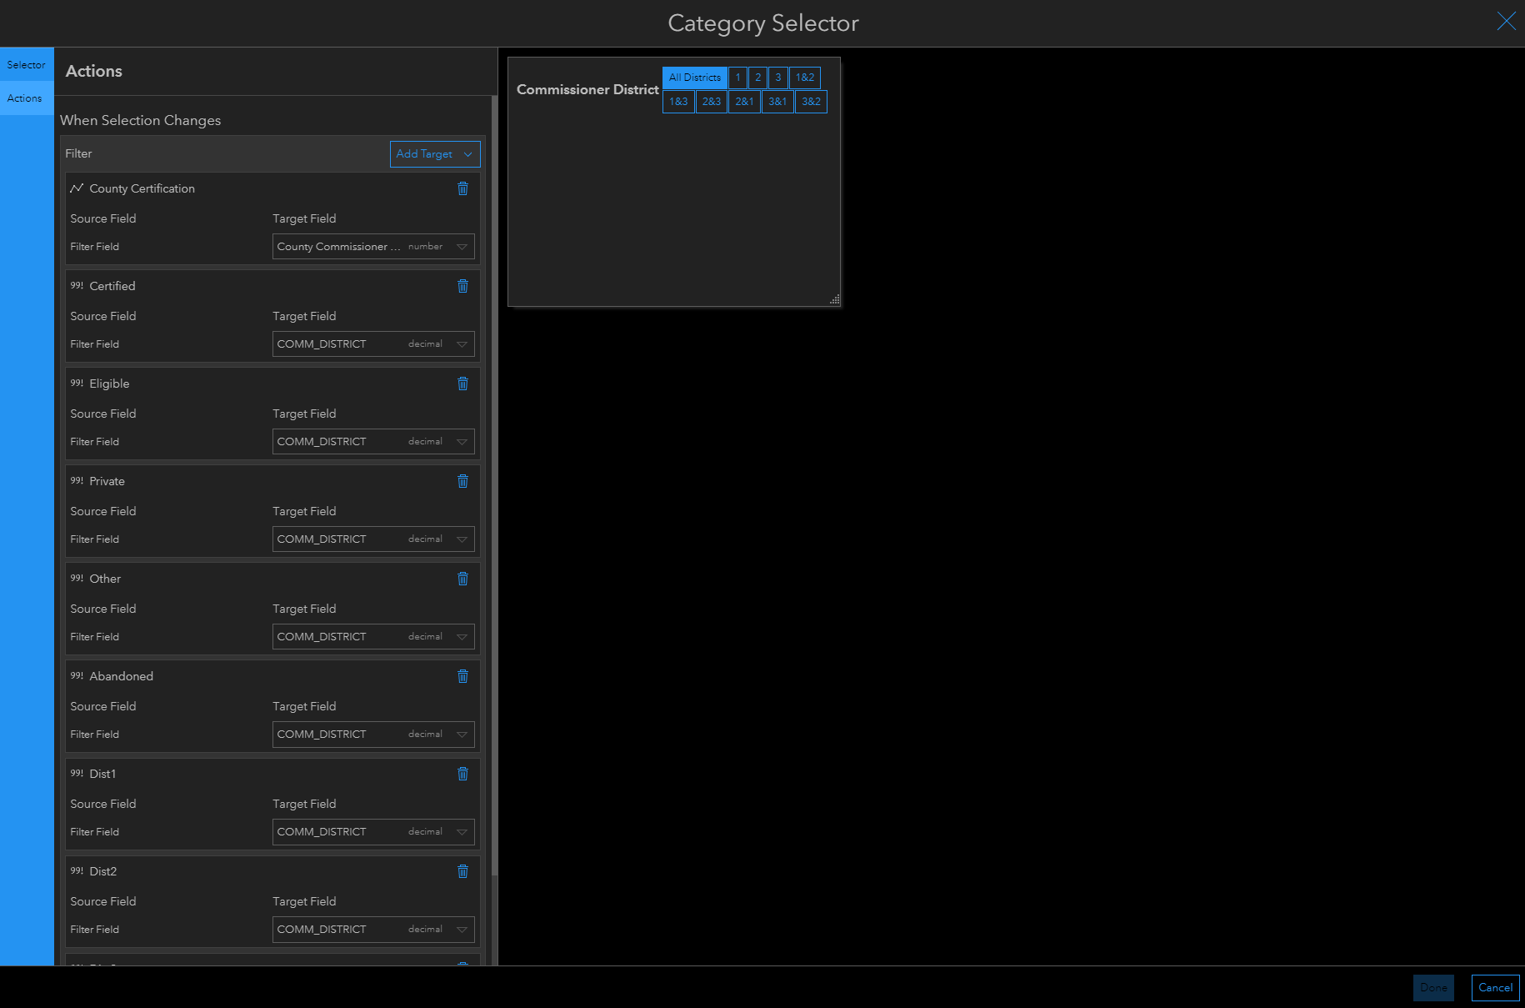
Interactivity Options
Actions
Map Extent
Selections on Elements
URL Parameters
Selectors
Category
Number
Date

Slide 21
Lessons We Learned

Slide 22
Lessons We Learned
Know your data
Everything hinges on how your data is set up
Field Types
Domains
Start Small
DO a simple dashboard first
DON'T jump into a large project with multiple dashboards and data connections and a website
Mess with the settings
Make duplicates to see what different settings do
Ask for help
ArcGIS Help
Listserv Community

Slide 23
Questions?
Gwen Johnson Devin Hargus
Gjohnson@odot.org Dhargus@odot.org
(405) 521-4121 (405) 522-1036
ODOT's Map and Data Portal: https://okdot.maps.arcgis.com

